Slide 1


The Sudoku Helper
By: Andrew Blonquist

Slide 2


The Problem:
Sudoku has the capability to become extremely difficult and when training your brain with these difficult puzzles its hard to stay focused when your stuck on a number.
This can lead to many people not willing to put in the few minutes a day to keeping their minds healthy and focused.

Slide 3

The Solution
Imagine your taking a test that you studied extremely hard for. You come to a problem where you forgot one simple that’s holding you back from completing all the steps you remember.
This is where a Hint button would come in handy. Giving you that next step answer to allow you to finish the rest of the puzzle.

Slide 4

Scenario 2
Maybe you’re the person that learns better by having a problem completed and then looking back and learning how they got the answer.
This is where a Solve button would come in handy, giving you that option of rather than just giving up even after you have seen a hint you can see the entire puzzle completed and go back too see how they got each number.

Slide 5
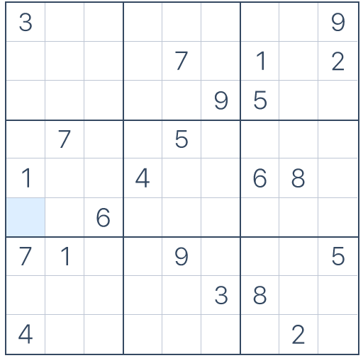
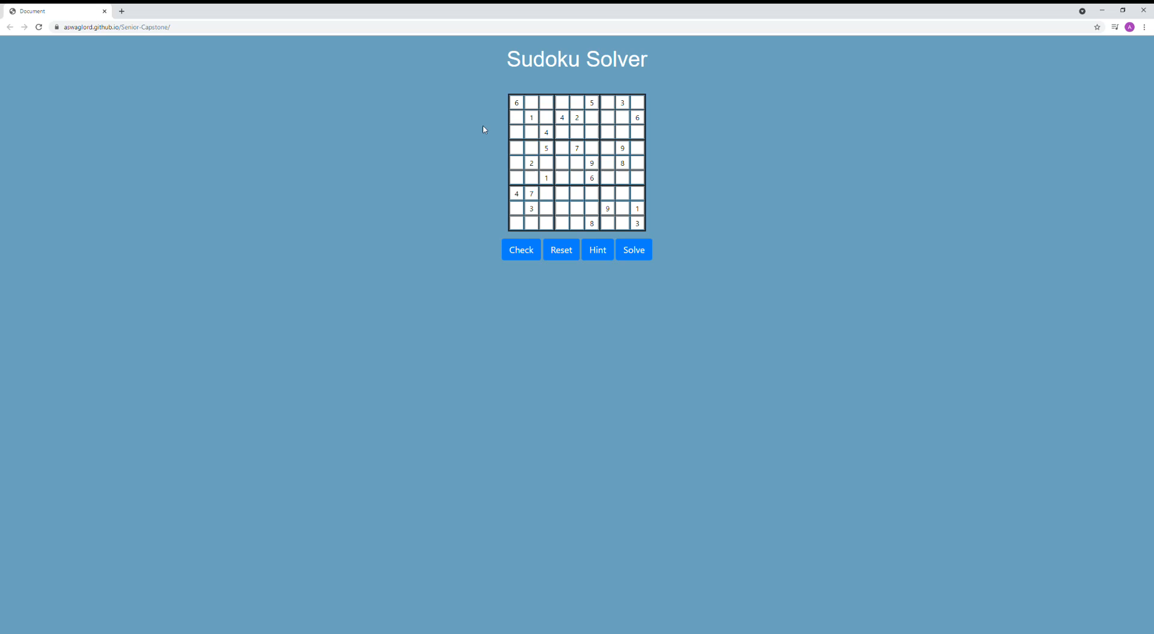
Demo
https://aswaglord.github.io/Senior-Capstone/
Pre Recorded Demo:

